Slide 1
Wireless Networks
Lecture 12
Fundamentals of Cellular Networks (Part II)

Slide 2
Outlines
Channel Assignment Strategies
Handoff Strategies
When to handoff
1G, BS based
2G or today's, Mobile-Assisted
Prioritizing Handoff
Guard channels concept
Queuing handoff requests
Practical handoff considerations
Umbrella cell
Cell dragging

Slide 3
Channel Assignment Strategies
For efficient spectrum utilization, frequency reuse scheme should be consistent with objectives
Increasing system capacity
Minimizing interference
Strategies can be classified as Fixed and Dynamic
In Fixed Channel Assignment Strategy,
Each cell is allocated a predetermined set of voice channels.
A call attempt can only be served if unused channel in that particular cell is available
If all channels are occupied then the call is blocked
Notes:
Choice of channel assignment strategy impacts the performance of the system, particularly as to how calls are managed when a mobile user is handed off from one cell to another.

Slide 4
Several variation exist like borrowing strategy
A cell is allowed to borrow a channel from neighboring cell if all of its channels are occupied
A mobile switching center (MSC) supervises such procedures and ensures that borrowing of channel does not disrupt the or interfere with any of the calls in progress in the donor cell
Dynamic Channel Assignment Strategy
Voice channels are not allocated to cells permanently
On each call request, the BS requests a channel from MSC.
MSC allocates a channel by taking into account
the likelihood of future blocking within the cell
The frequency of use of the candidate channel, reuse distance

Slide 5
Hence, MSC only allocates a channel if that is not presently in use in the cell which falls within minimum restricted distance of frequency reuse.
It reduces the likelihood of the call blocking, increasing the trunking capacity of the system.
It requires MSC to collect real-time data on channel occupancy, traffic distribution and RSSI of all channels
This increases storage and computational load on the system
But provides increased channel utilization and decreased call blocking

Slide 6
Handoff Strategies
Handoff: a mobile user moves to a different cell while conversation is in progress, MSC transfers the call to a new BS.
Identifying new BS
New voice and control channels to be allocated
Handoff must be performed
Successfully
To achieve this, designer must specify optimum signal level at which handoff initiates

Slide 7
Once, a signal level is specified as min usable for acceptable voice quality
A slightly stronger signal level is used as threshold
Normally taken between -90dBm and -100 dBm.
This margin ∆ = Pr_handoff – Pr_min, can not be too large or too small
If ∆ is too large, unnecessary handoffs, burden on MSC
If ∆ is too small, insufficient time to complete a handoff before a call is lost due to weak signal
∆ should be chosen carefully to meet conflicting requirements

Slide 8
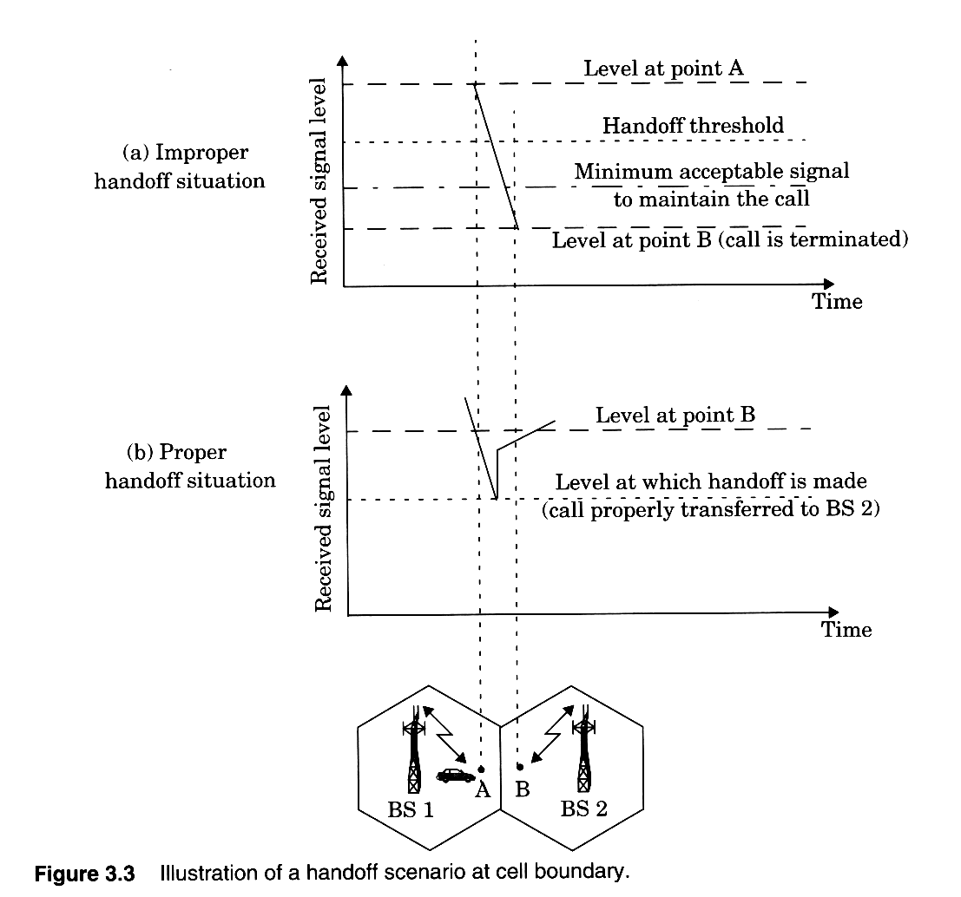

Slide 9
Call drops
Excessive delay by MSC due to high traffic load
∆ is set too small for handoff time
No channels are available on any of nearby BS
When to handoff,
Drop in signal level is not due to momentary fading
Mobile is actually moving away from serving BS
To ensure this,
BS monitors the signal level for certain period of time
The period depends on the vehicle speed
If slope of average received signal level is steep, handoff is made quickly

Slide 10
In 1G, signal level was measured by BS and supervised by MSC
Each BS constantly monitors the signal strength of all its reverse channels to determine relative location of each mobile user
In addition, the locator receiver (a spare receiver) is used to scan and measure RSSI of mobile users in neighboring cells and reports to MSC
Based on these measurements, MSC decides if handoff is necessary

Slide 11
Mobile assisted handoff (MAHO)
In 2G, handoff decisions are mobile assisted
Each mobile measures RSSI of all surrounding BS
Reports to serving BS
Handoff is initiated if power of serving BS is lesser than nearby BS by a certain level or for a certain period of time
Enables calls to be handed over between Base Stations at much faster rate than in 1G
MSC no longer constantly monitors RSSI.
More suitable for microcellular where HO is frequent

Slide 12
intersystem handoff
If a mobile moves from one cellular system to a different system controlled by a different MSC
Issues to be addressed
A local call becomes a long-distance call (roaming)
Compatibility between two MSC must be determined
Different systems have different policies and methods for managing handoff requests
Prioritizing handoff
Call termination in middle of conversation is more annoying than being blocked on a new call attempt

Slide 13
Prioritizing Handoffs
Two methods of handoff prioritizing
Guard channel concept
A fraction of available channels is reserved exclusively for handoff requests
Has disadvantage of reducing total carried traffic
Offers efficient spectrum utilization when dynamic channel assignment strategies by minimizing number of required guard channels

Slide 14
Queuing of handoff requests
Possible due to time interval elapsed when the signal level drops below to threshold until minimum signal level
Decrease probability of forced termination due to lack of available channels
Tradeoff between decrease in probability of forced termination and total traffic
The delay time and queue size is determined from traffic pattern
Queuing does not guarantee zero probability of call termination since large delays will signal level to drop min

Slide 15
Practical handoffs consideration
Several problems arise to design a system for wide range of mobile velocities
High speed vehicles pass through a cell in a matter of seconds
With micro cells addition, the MSC can quickly become burdened
Pedestrian users may never need a handoff during a call
Issues
Schemes to handle high speed and low speed users simultaneously
Ability to obtain new cell sites

Slide 16
Additional capacity is provided through addition of new cell sites,
Difficult to obtain new cell sites
Install additional channels and BS at same location of an existing cell
By using different antenna heights and power levels, possible to provide large and small cells, which are co-located at single location called umbrella cell
Provide large coverage area to high speed users minimizing number of handoffs
Small coverage to slow speed users
Speed can be estimated by BS or MSC by RSSI

Slide 17
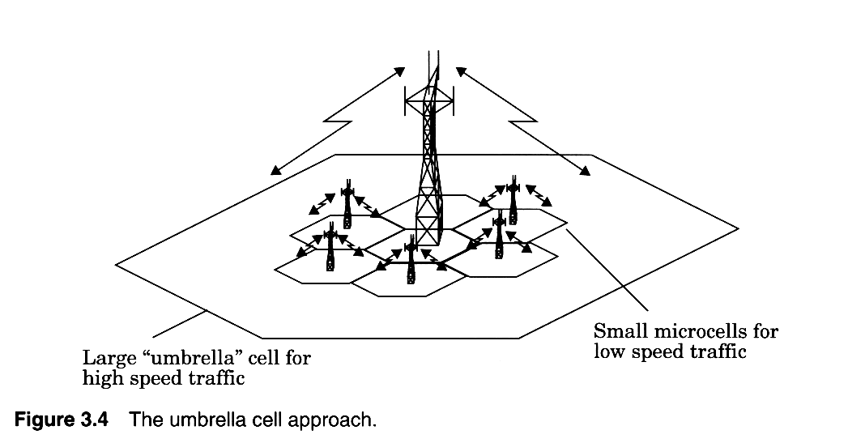

Slide 18
Cell dragging
Problem in micro-cell due to high signal strength of pedestrian users.
Occurs in urban areas when there is a LOS path
Average signal strength does not decay rapidly even if a user travels well beyond the range of cell
The RSSI may be above the handoff threshold and thus handoff is not made
This creates potential interference since a user has traveled deep within a neighboring cell
Handoff parameters, threshold must be adjusted carefully

Slide 19
In 1G,
time to make handoff when signal drops below threshold is 10s.
This requires that the value of ∆ be on the order of 6 dB to 12 dB.
In 2G
such as GSM, MAHO determines the best handoff candidates and requires only 1 or 2 seconds.
∆ is usually between 0 dB and 6 dB.
Provides MSC substantial time to rescue a call that is in need of handoff

Slide 20
In IS-95 (CDMA) system
Provides unique handoff capability that can not be provided in with other wireless systems
Unlike channelized (hard handoff), SS mobiles share the same channel in every cell.
Thus handoff does not assign channel but a different BS handles a communication task
By simultaneously evaluating RSSI from single user, MSC decides which version of the signal is best
This ability selects between instantaneous received signals from a variety of BS is called soft handoff

Slide 21
Summary
Channel Assignment Strategies
Handoff Strategies
When to handoff
1G, BS based
2G or today's, Mobile-Assisted
Prioritizing Handoff
Guard channels concept
Queuing handoff requests
Practical handoff considerations
Umbrella cell
Cell dragging

